Slide 1
Adversarial Training based HRNet (HRGAN)
Group 15
Presenter:
Ting Cao Siyuan Yan Gefei Zhang Luning Li
(u7078470) (u7050317) (u7138112) (u7077148)

Slide 2
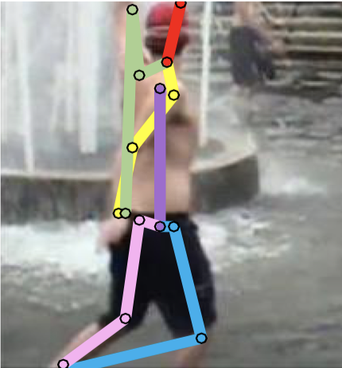
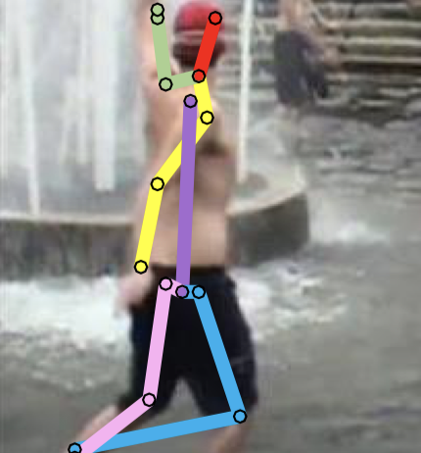
Challenge—Implausible pose

Slide 3
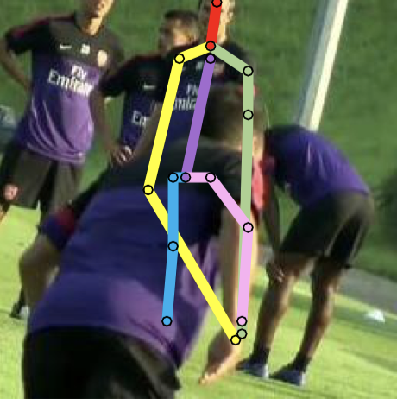
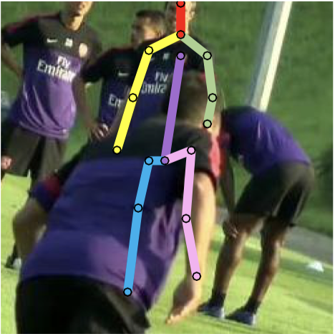
Challenge—Occlusion

Slide 4
Objective
To prove the effectiveness of adversarial training on HRNet
To solve the occlusion problem in crowded scene
To correctly assign implausible pose

Slide 5
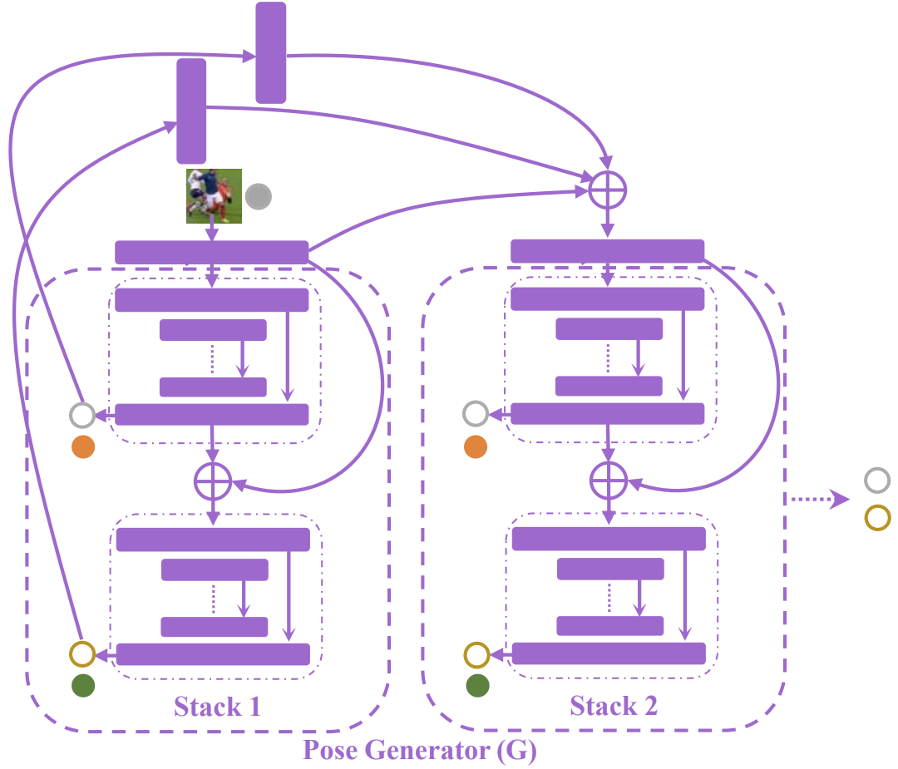
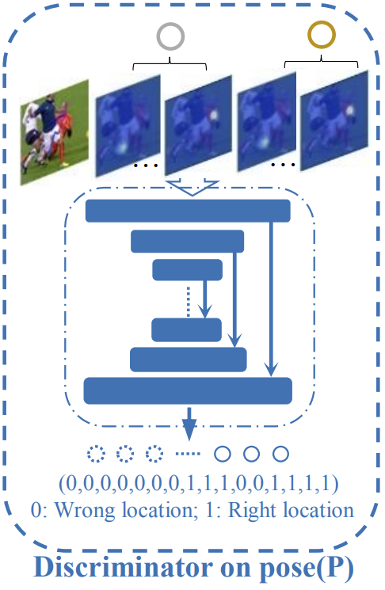
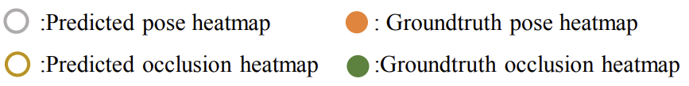
Previous work—GAN
Notes:
Previously, a typical adversarial training framework will use hourglass as the base model, the idea is, if we use an additional discriminator to discriminate predict heatmaps with ground truth,

Slide 6
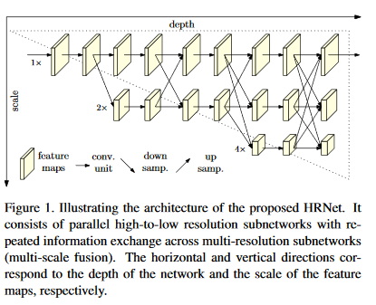
Previous work—HRnet

Slide 7
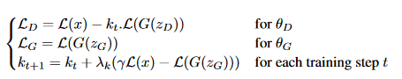
Previous work—BEGAN
Boundary equilibrium

Slide 8
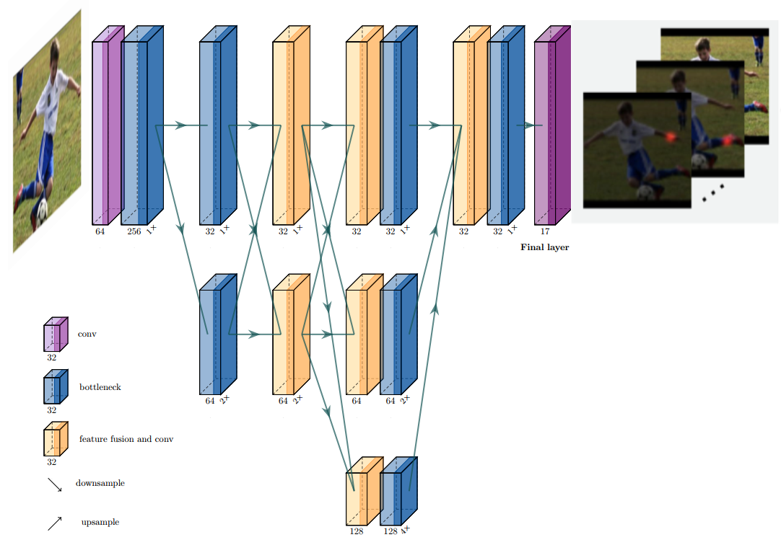
Architecture—Generator

Slide 9
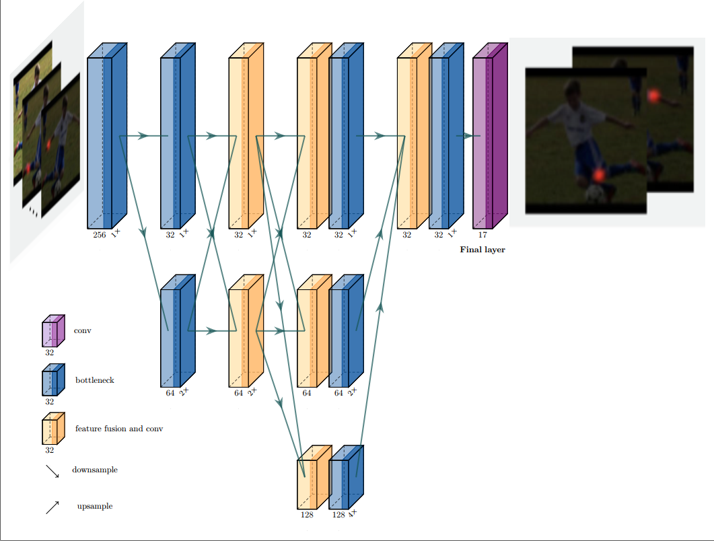
Architecture—Discriminator

Slide 10
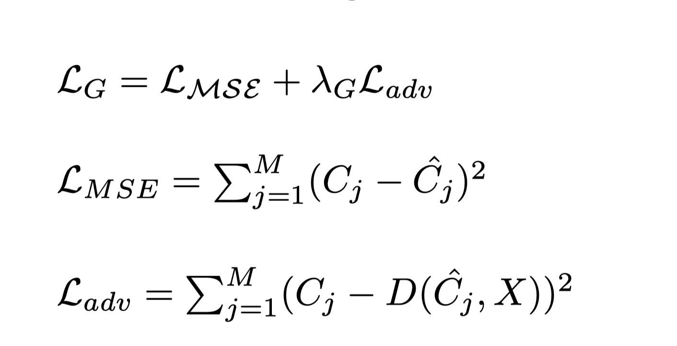
Training Strategy for Generator
content loss and adversarial loss
Notes:
Hello, this is Siyuan. I’m going to talk about the training strategies and our boundary equilibrium.
For the generator, we have a MSE loss, and an adversarial loss.
The MSE loss computes the difference between ground truth heatmap and the generated heatmap.
As for the adversarial loss, It computes the error between generated heatmaps and reconstructed heatmaps.
Lambda G is a used to control the weight of adversarial loss.

Slide 11
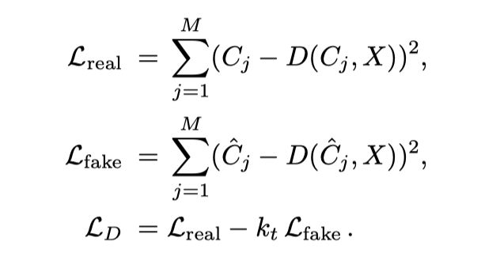
Training Strategy for Discriminator
Notes:
As for the discriminator,
L_real is trained to minimize the error between ground truth and reconstructed heatmaps.
L_fake is trained to reconstruct totally different ones, which to maximize the error between generated heatmaps and the reconstructed ones.
LD is optimized by per-pixel loss with a control term kt, I will explain this term kt later. For a particular pose, the discriminator will compute the error between input and output heatmap of the discriminator.
If one keypoint is high nearby the other keypoint, the discriminator will produce a heatmap that the one keypoint has a larger error at the location of the other keypoint, avoiding joint mismatch. By this method, the model can tackle the occlusion problem well.

Slide 12
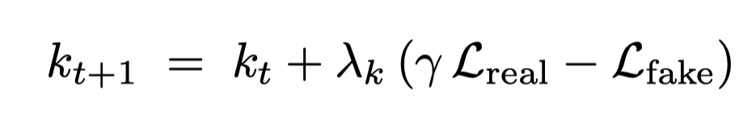
Boundary Equilibrium
To control the balance between generator and discriminator.
To solve the mode collapse
Notes:
GAN is unstable and hard to train when the discriminator gets better too quickly. Inspired by BEGAN and the paper “self-adversarial training for human pose estimation”, we use a term kt to control the balance between discriminator and generator.
If gamma multiplies loss real is larger than loss fake, then generator gets better than the discriminator.
So, kt will increase, discriminator will be trained more on generated heatmap.

Slide 13
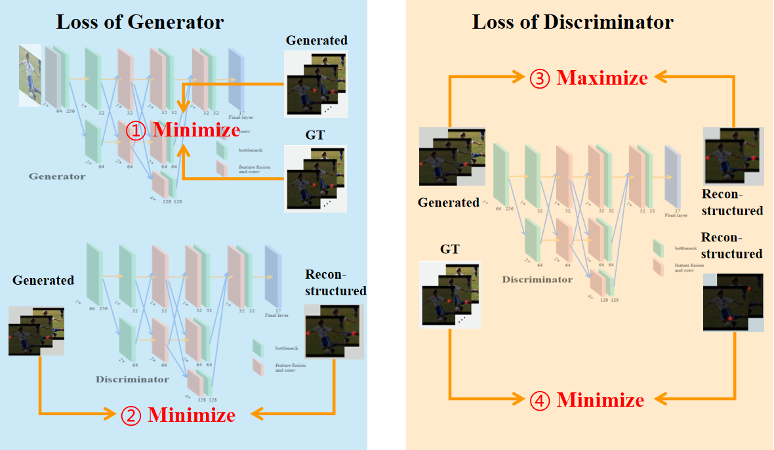
Adversarial Training Process
C.-J. Chou, J.-T. Chien, and H.-T. Chen. Self adversarial training for human pose estimation, 2017
Notes:
In summary,
Our training scheme is
For the generator. it is trained with mse loss along with an adversarial loss.
For the discriminator, it maximizes the error between reconstructed heatmap and generated heatmap, so that the reconstructed one is totally different from the generated one.
Also, it minimizes the error between reconstructed heatmap and ground truth heatmap, so that make they are similar.

Slide 14
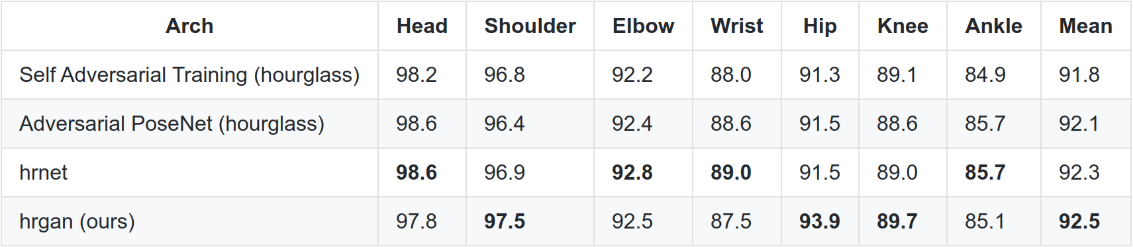
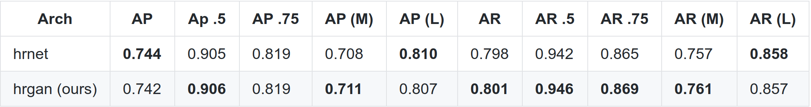
Experiment Results
MpII trained on 1 V100 GPU, ~90 epochs
COCO trained on 4 V100 GPUs, ~130 epochs
MPII
COCO

Slide 15
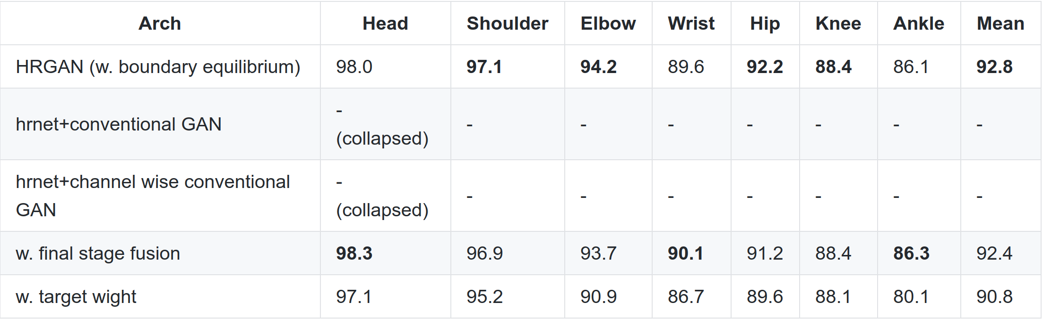
Ablation study

Slide 16
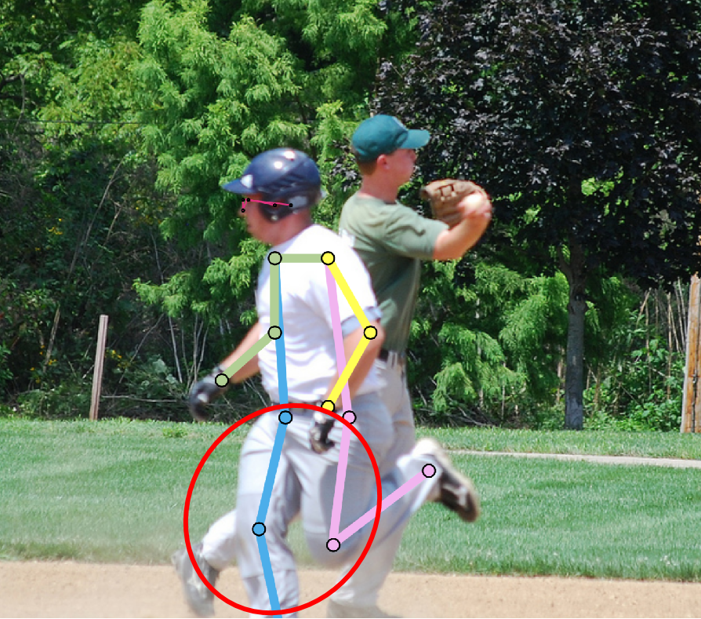
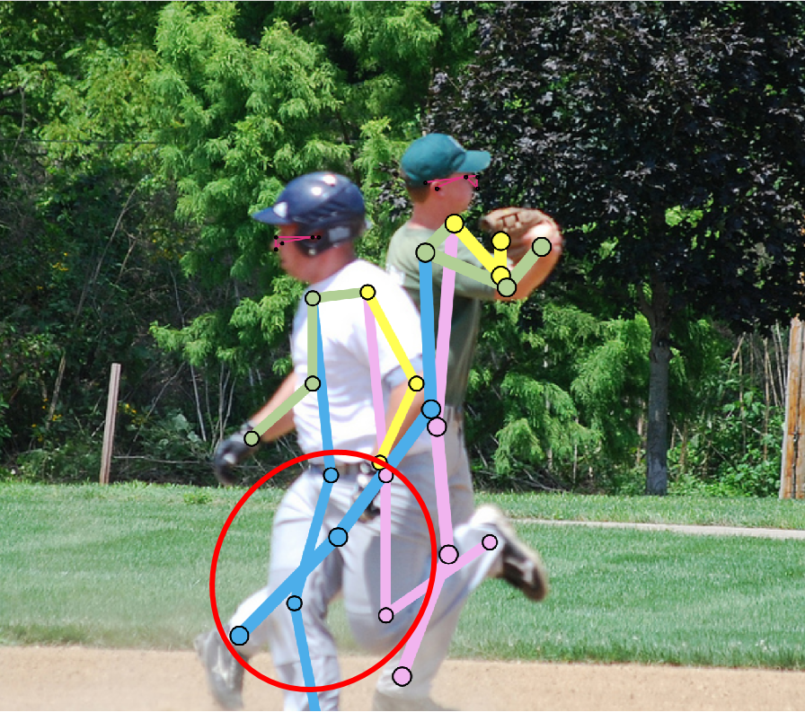
Occlusion
HRNet Our HRGAN

Slide 17
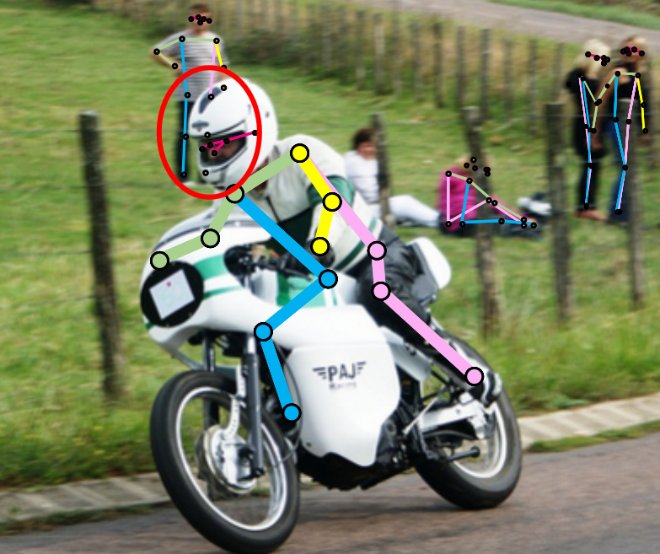
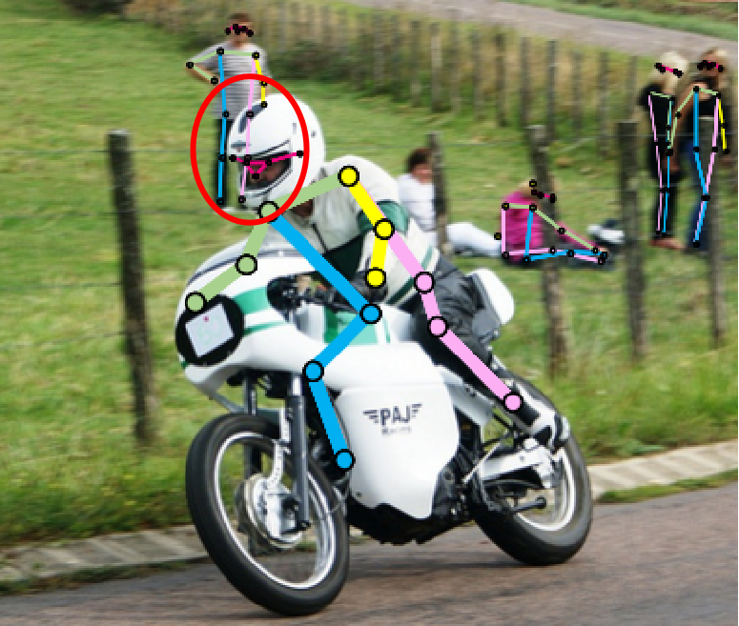
Occlusion
HRNet Our HRGAN

Slide 18
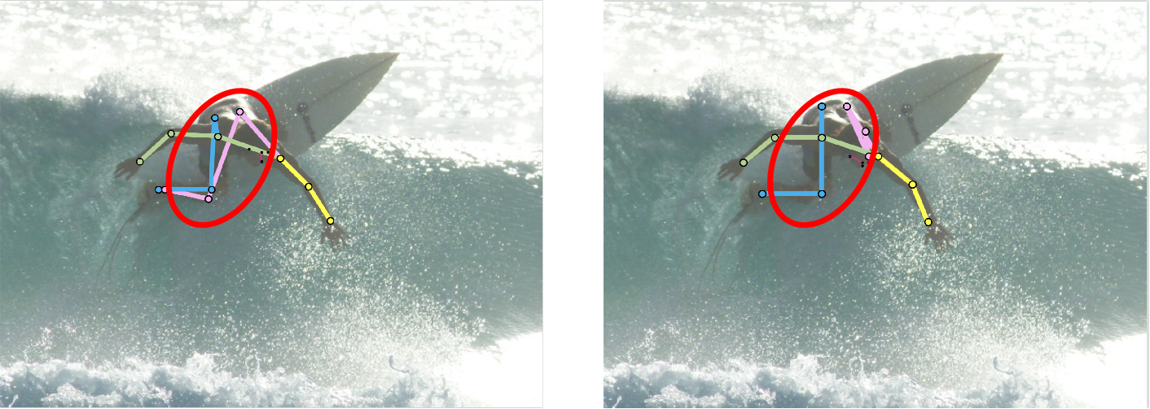
Implausible Pose
HRNet Our HRGAN

Slide 19
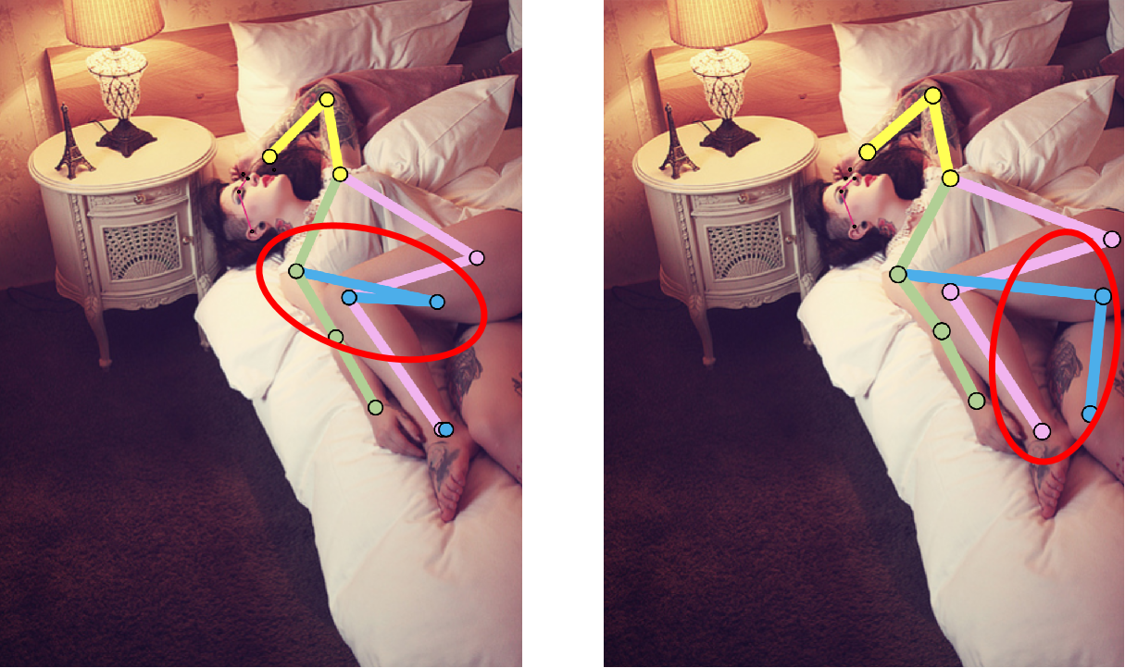
Implausible Pose
HRNet Our HRGAN

Slide 20
Limitation
Performance is limited to its detection model
High computational cost

Slide 21
Conclusion
We proposed an adversarial training based HRNet called HRGAN.
We solved the implausible pose and occlusion problem in HRNet.
We outperformed state-of-the-art top-down model HRNet in MPII.

Slide 22
Future Work
Explore methods which can detect small person and low resolution
Extend to bottom up method

Slide 23


